Slide 1
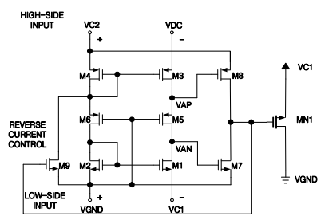
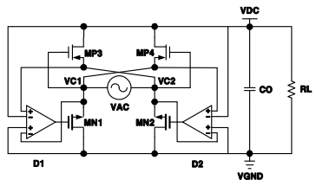
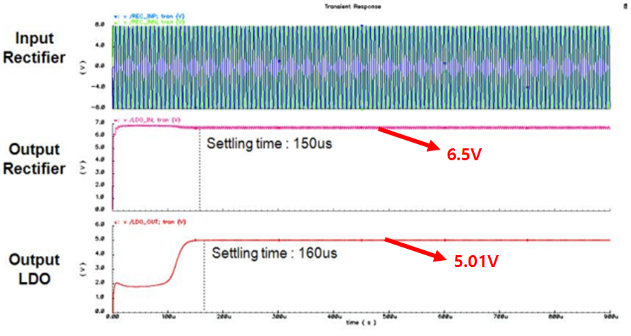
A Design of High Efficiency IC for Wireless Power Transfer
System Application
Tae-Wan Kim ¹, Tae-Young Yoon², Sang-Gyu jeon³, Jong-Wan Jo⁴ and Kang-Yoon Lee
Department of Electrical and Computer Engineering, Sungkyunkwan Univ.
Introduction
Structure
1
1
miniaturization and efficiency improvement of the blocks which are difficult to implement by the ASIC. The main circuit necessary for power management can be integrated to achieve cost reduction and circuit simplification
we propose a new Ubiquitous Sensor Network (USN) system which is designed to transmit various information to users in various places of life through USN
< Schematic of active diode>
Structure
Diode currents are prevented from crossing each other at the same time, thereby preventing leakage current and improving power conversion efficiency
1
< Block diagram of LDO >
< Simulation of LDO>
The active diode compares the current output DC voltage with the input voltage to reduce the loss of power by clarifying the ON / OFF operation compared to the NMOS diode connection structure
When the diode MOS receives the input voltage directly, the output voltage is formed with a difference of Vth voltage for turning on the MOS
MOS is turned on / off by comparing the input and output voltages using the comparator, It is characterized by a lower voltage difference than using a connection MOS
when the 6.5V output from the active diode rectifier is used directly without the dc-to-dc converter. The output voltage is about 5.01V, and when the dc- The output voltage swing of about 30mV was confirmed in the simulation situation
Conclusion
1
we design an integrated circuit of a transmitter and receiver circuit for a wireless power transmission system using 0.35um process
The system is designed to supply 3W to the recharging of the portable terminal, and the design has been designed to maintain high efficiency in each block
(maximum power efficiency 72%)

